Slide 1
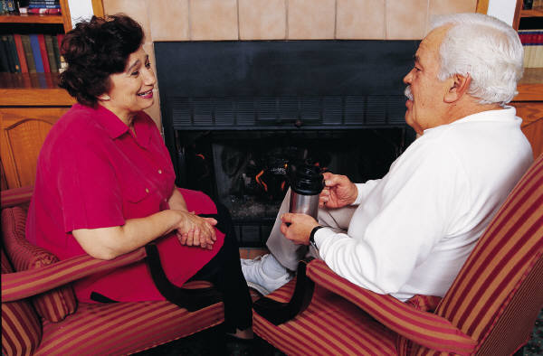
MEANINGFUL, SUSTAINABLE ACTIVITIES FOR SENIOR CITIZENS
By Designers For Tomorrow
Candice Bowes, Nuha Gendi, Julie Seward
Design Challenge Part 2
EDIT 771
Spring 2014

Slide 2
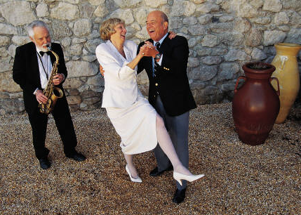
Overview
In a search to answer the question, “How can communities provide meaningful, sustainable activities for older adults?” and thus improve the quality of life for senior citizens, we went on a quest to discover what would make them happier and more comfortable. Several interviews were conducted and based on what they expressed the following solution was designed.

Slide 3
Desires Expressed by Senior Citizens
They would rather live in their own home.
They would like help with yard work and housework.
They feel lonely and they wish that people were nicer.
They would like more support with transportation.
They wish that people were more helpful and compassionate.
Many are leery of, but curious about, technology.

Slide 4
Proposal for Design Solution
To help with most of these issues, we propose that a service be organized where a team of professionals visits the home of each senior citizen to assess what needs to be modified to make their home compatible with their abilities and/or disabilities.
During this visit, they would also be given an iPad on which we would have our Senior Power app installed.
This app can be accessed at the touch of a button and will be portable and readily accessible with internet access.
To encourage the use of the app and to engage our seniors, we would teach them how to use the Ipad and incorporate a game app, known as Senior Points, to be used in conjunction with the Senior Power app.

Slide 5
Needs Addressed by the Senior Power App
Senior Power App
Loneliness
Friendship,
Companionship
Love, Care, Compassion
Home Improvement

Slide 6
Explanation of Ipad Prototype
Seniors would be taught how to use an Ipad and would receive necessary support in establishing connectivity.
They would be shown the Senior Power app and the Senior Points game.
They would be given the option of playing for points or playing for coupons and gift cards from local merchants. They could also switch back and forth as desired.

Slide 7
iPad Home Screen with Senior Power App
Senior Power

Slide 8
Senior Power App Screen

Slide 9
How to Play
Each time they engage in an activity listed under the category headings, they earn either Life Points, or coupons from local merchants $ $ $.
When they reach 10 Life Points in a single category, they receive a badge or gift cards from local merchants.
The game would allow them to view each other’s points and badges to foster the spirit of competition all while doing things to improve their own quality of life.
Races for badges or gift cards could be instituted between players and new competitions between players could be started as desired.
Celebrations of goals reached could be incorporated as well, depending on the clients’ interests. These celebrations could be individual or social!
10
20
30

Slide 10
Senior Points Score Pad
Arena | Life Points Earned | Badges Earned
Emergency Services
Nurse
Medication
Groceries
Take Out
Transportation
Personal Shopper
Maid Service
Social Connections

Slide 11
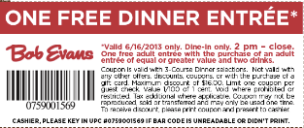
Coupons and Gift Cards Earned with Senior Points
Activity Category | Coupons Earned | Gift Cards Earned
Emergency Services | Not Applicable | Not Applicable
Nurse
Medications
Groceries
Take Out
Transportation
Personal Shopper
Maid Service
Social Network

Slide 12
Explanation of Senior Power Icons and Links to Existing Services
EMERGENCY : Once they click on this, the network will be able to track their whereabouts and send help wherever they are.
This tab would link to local 911 for emergencies and to local service numbers for non-emergencies.

Slide 13
NURSE : Things happen and sometimes people might need a nurse outside their scheduled weekly hours for example the flu or a fever. In such cases, clicking this button would alert the network to the need and they will send an on call nurse.
Services this tab could link to:
Inova Visiting Nurse Association Home Health
Medstar Visiting Nurse Association
Resource: Virginia Department of Health: Directory of Home Care Providers in Virginia

Slide 14
MEDICINE : This is used for refilling prescriptions. The app memorizes the client’s medications and once clicked, a list of medications comes up. Once filled, it is delivered to the house.
Pharmacies this tab could link to:
Costco Pharmacy
CVS Pharmacy
Rite Aid Pharmacy

Slide 15
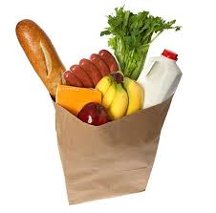
GROCERIES : The tab brings up a list of regularly purchased groceries. Once the items are chosen, they are delivered to the house and paid for either in cash or electronically through a link on the screen.
Grocery Deliver Services this tab could link to:
Giant: Peapod
Washington’s Greengrocer
Instacart

Slide 16
TAKE OUT: This provides a list of takeout menus from favorite local restaurants that deliver. The client chooses the food they want, pay for it electronically or opt for cash payment upon delivery, and it is delivered to their home.
Customizable Client Favorites (Sample List)
Seamless (a variety of restaurants)
Chipotle
China Express
Resource: Northern Virginia Magazine:
Cheap Eats 2014

Slide 17
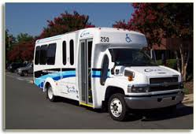
TRANSPORTATION : Getting a ride is simple! Just specify the date and time, and transportation will arrive as per client’s reservation.
Services this tab could link to:
MetroAccess Service
City Wheels Application
Seniors on the Go (taxi)
Resource: Fairfax Transportation for Seniors and disabled citizens

Slide 18
PERSONAL SHOPPER : What happens when the client’s clothes wear out and they can’t go shopping? Well, their personal shopper will get a list of needs as well as likes and dislikes and do their shopping for them! Returns and exchanges are included in the service!
Services this tab could link to:
It’s Your Time
On Task Errand Services
Nordstrom Stylist Service

Slide 19
MAID SERVICE : Accidents happen! There are many reasons that might lead someone to need maid service on a regular or occasional basis. Clicking the button will make sure they get the service ASAP!
Services this tab could link to:
The Maids
Let’s Clean Services
Progressive Cleaning
Potomac Maids

Slide 20
SOCIAL NETWORK: The service seniors need the most! It has two options:
Lets them know the social events going on for that day, week, and month.
Lets them request a companion to come over to read, play, or simply talk.
Services this tab could link to:
Fairfax County Events Calendar
City of Fairfax Special Events
Fairfax City Patch Social Events
Always Best Care of Fairfax (Companions)
Adult Companion Care, Inc.

Slide 21
Senior Points Game
Gaming has been shown to be an effective way to engage learners and participants to a greater level than passive exposure to content. Senior citizens are no exception! They can benefit from the bonuses of the gaming experience through their participation in the Senior Points game.

Slide 22
Gaming Elements in Senior Points
Competition
Sociality
Progressive
Levels
SeniorPoints

Slide 23
Areas of Focus for Senior Points
Senior Points would give seniors the opportunity to earn points and badges in the following areas.
Physical Health
Emotional Well-Being
Intellectual Stimulation
Social Connections

Slide 24
How to Earn Points Physical Health Activities
Go for a walk, swim, or bike ride.
Use the Nurse feature on Senior Power to ask a question about your health.
Try a new exercise class like yoga or water aerobics.
Use the Groceries feature on Senior Power to order vegetables, fruits, and healthy snacks.
Eat at least 5 servings of vegetables in one day.
Drink 8 full glasses of water in one day.
Dance (You pick the music, the step, the place, and your partner, if any!)
Stretch your arms over your head and hold for 10 seconds.
Stretch your legs out in front of you and try to touch your toes.
Play with a child.
Ride a bike.
Use the Medications feature on Senior Power to refill your prescriptions.
Use the Emergency Services feature on Senior Power to call for help in an emergency. (Hopefully, you won’t ever need to earn points this way!)

Slide 25
Emotional Well Being Activities
Make a list of things you are grateful for today.
Create a scrapbook of your favorite memories.
Use the Maid Service feature on Senior Power to get help with cleaning up your home, then enjoy the boost it brings to your spirits!
Listen to your favorite music.
Watch your favorite movie.
Use the Social Network feature on Senior Power to reach out to someone.
Read to a child.
Volunteer to help someone.
Write a letter to someone you care about.
Sing your favorite song.
Treat yourself to something you really enjoy today.
Use the Personal Shopper feature on Senior Power to request help with shopping for something nice to wear.
Spruce yourself up and look your very best today.

Slide 26
Intellectual Stimulation Activities
Read a non-fiction book about something that interests you.
Learn a new skill on the computer.
Try a new recipe or a new game.
Learn to use the features on Senior Power to reach out and get the things you need.
Download a new game to play on your Ipad.
Play that new game either by yourself or with a friend.
Work a crossword puzzle.
Help a child with his or her homework.
Explore a new craft, hobby, or other interest.
Teach someone how to do something you are good at.
Organize an area of your house.
Take a class in something that interests you.

Slide 27
Social Connections Activities
Go out to eat with one or more friends.
Use the Social Connections feature on Senior Power to learn about events in your community.
Call someone you haven’t spoken with for a while.
Join a group that does something you enjoy.
Use the Transportation feature on Senior Power to go somewhere you need or want to go.
Invite one or more people to your home to eat, visit, or play a game.
Strike up a conversation with someone you meet for the first time today.
Work with someone to plan a surprise for someone else.
Create an account on Facebook or Twitter.
Post something on your account to share with others.
Go on a trip with someone you care about.
Organize a family reunion.

Slide 28
Challenge Met!
Design Challenge: To design a way to create meaningful, sustainable experiences for older adults.
Needs/Desires Expressed by Senior Citizens Interviewed:
They would rather live in their own home.
They would like help with yard work and housework.
They feel lonely and they wish that people were nicer.
They would like more support with transportation.
They wish that people were more helpful and compassionate.
Many are leery of, but curious about, technology.
Design Solution: Senior Power and Senior Points
Technology Used for Prototype: iPad App
Gaming Elements Used: Sociality, Competition, Progressive Levels

