Slide 1
Reflections on UX & the EDIT 732/752 Journey
Anne Millen-Martini
Nkiruka Ogbuchiekwe
Julie Steward
Eric Reeves
Anna “Anya” Stolpe
Ying “Olivia” Wang

Slide 2
What is UX and what does it have to do with instructional design?
INSTRUCTIONAL DESIGN
USER EXPERIENCE
Both processes demand frequent iteration & interdisciplinary collaboration
Even more important,
UX principles
bring the ideal of
learner-centered design
to the next level
Notes:
Heading would start in center, move to top & fade and bullets “fade in” and go to center. Show the two processes as gears, with the two touching in the analysis stage. UX4ID logo in bottom right corner – need two cycles written into the two gears

Slide 3
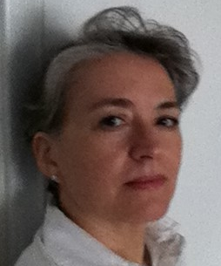
Julie Steward
M.Ed. Candidate
Curriculum & Instruction
Anna Stolpe
M.Ed. Candidate. DOS Language & Culture Instructor
Olivia Wang
M.Ed Candidate
Curriculum & Instruction
Everyone on our team had some background in instructional design prior to this course, but none had explored user experience principles in any depth.
Nkiruka Ogbuchiekwe
M.Ed. Candidate
Deloitte Consulting
Anne Millen-Martini
M.Ed Candidate
Teacher
Eric Reeves
Ph.D. Candidate
Lockheed Martin
Notes:
UX4ID on entire screen, shrinks to show all of us again for about 5 seconds.

Slide 4
Julie Steward
M.Ed. Candidate
Curriculum & Instruction
Problem
Client
Process
Designer
End User
Previous Paradigm:
Problem
End User
Designer
Process
Client
UX Paradigm
Notes:
Julie’s image & logo opposite corners, Previous Paradigm appears, UX Paradigm appears, crossout sign appears over previous paradigm

Slide 5
Our job is to connect user needs to our design, producing effective work that pleases client and user alike.
It becomes too easy to start and finish with the client’s perspective. We need to take a step further and understand what makes the end user’s life easier, which will please the client as well.
Notes:
Julie’s picture & logo in opposite corners, storyboard image with comment that starts “it is too easy” for 10 seconds. Fade this comment & image, bring in comment that starts “Our job” and 2 images about delight.

Slide 6
We learned that
“It depends” is not a
cop-out, it is a mindset.
Anne Millen-Martini
M.Ed Candidate
Teacher
Notes:
Anne’s pic in bottom center, logo bottom corner, Text appears in center top of screen.

Slide 7
To understand the needs of an individual user
adapt research testing methods to meet
the needs of the “perfect”participant
create a persona
be ready to ignore a traditional UX guideline or fight to adhere to one as the situation demands
Notes:
Anne pic & logo same place, To understand comment at top. Create a persona appears with diagram of how we narrowed it down. Previous fades as “adapt research methods…” appears with images of paper prototype, a google docs link, the title of our r1 script. Previous fades and “be ready…” appears in center.

Slide 8
Olivia Wang
M.Ed Candidate
Curriculum & Instruction
We learned that process is all in UX.
Work with different data collection and analysis techniques. It will improve your general understanding and future projects.

Slide 9
be multi-disciplinary
& collaborative
focus on the user
research
analyze
evaluate
Iterate
go the extra mile
find the tool
???
use the tool
Ask the question
Notes:
Olivia’s image & logo top & bottom right, “we learned…”. Don’t Panic! ☺ The rest of text and needed images would appear in a sequence, starting going left to right from “focus on the user” to evaluate, then the 3 iterates, find/use tool, ask question, go… mile.

Slide 10
We learned that risk and failure must be acceptable in the
UX process.
Notes:
I admit it, I have no idea how to use images to demonstrate this. We’ve got two screens. We can use animation. Any ideas ladies?

Slide 11
User Experience Design involves continuous decision making. Only risk enables the process to proactively address and mitigate issues that might otherwise arise after a product has been launched.
Nkiruka Ogbuchiekwe
M.Ed. Candidate
Deloitte Consulting

Slide 12
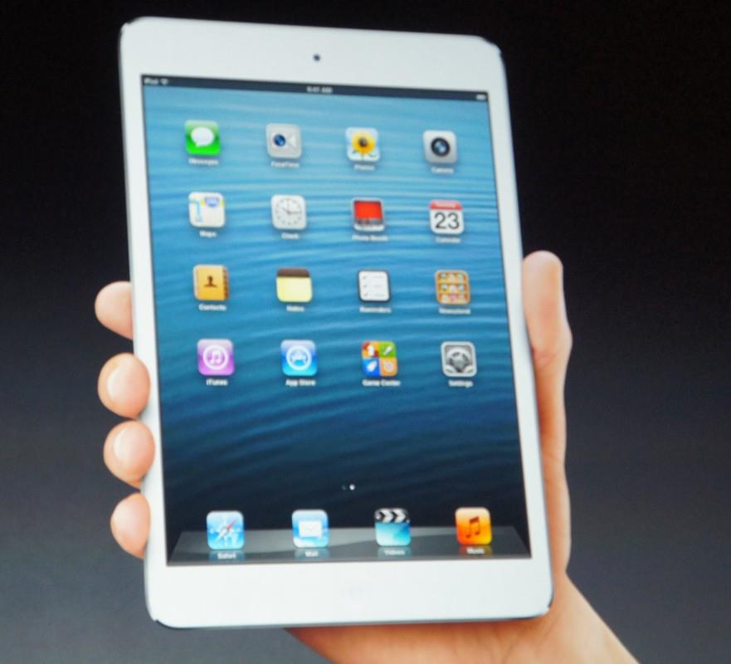
Find out what makes sense to the user, whether you are focusing on navigation and content or how a device fits into your hand and whether you can use it in direct sunlight.
If the learner can't find it, it doesn't exist
We learned that uncovering what is intuitive to the learner is more difficult than it looks.
Notes:
I’ve got some ideas for this… I think it works a lot like Olivia’s in that we need to parse it down into 2-5 word phrases with images of people who are confused, people who are happy, something that captures navigation visually (a compass?), an image of a device in someone’s hand, etc… Two screens and animation help!

Slide 13
Anna Stolpe
M.Ed. Candidate. DOS Language & Culture Instructor
We need to dig deeper into how the users think and act. Evidence-based practice is a good approach, but user-based is much better, especially when the goal is to better understand how a user thinks and learns.

Slide 14
We learned that UX adds “heart” to product development.
UX
The most successful user experience design occurs when the product addresses a need that the customer didn’t know they had or didn’t know how to express.
Eric Reeves
Ph.D. Candidate
Lockheed Martin
Market analysis
Instructional Design
Industrial Design
Engineering
HTML Development…
Notes:
Eric’s Picture bottom right, logo top left. Superimpose heart with UX inside it onto a development cycle visual? The second sentence is a text box, the word delight grows and glows, Logo takes over screen with last sentence under it on second slide.

Slide 15
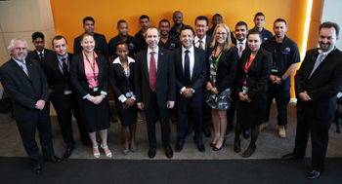
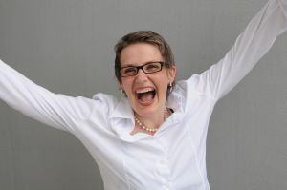
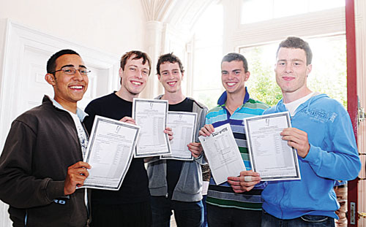
This causes the elusive delight
we all strive to produce in our users.
Going beyond functionality and usability
to delight enables us to meet the end user’s
needs in a clear and beautifully designed way.

Slide 16
What did we learn about UX?
Put our end user, THE LEARNER, first.
Designing for the individual demands flexibility in nearly every part of the UX process.
UX really IS all about the process.
Risk and failure lead to better UX.
Do the hard work to uncover what will be truly intuitive for the user.
UX puts heart into the design and development process, allowing us to strive for truly delighting our end users.

Slide 17
Julie Steward
M.Ed. Candidate
Curriculum & Instruction
Anna Stolpe
M.Ed. Candidate. DOS Language & Culture Instructor
Olivia Wang
M.Ed Candidate
Curriculum & Instruction
Nkiruka Ogbuchiekwe
M.Ed. Candidate
Deloitte Consulting
Anne Millen-Martini
M.Ed Candidate
Teacher
Eric Reeves
Ph.D. Candidate
Lockheed Martin
Notes:
UX4ID on entire screen, shrinks to show all of us again for about 5 seconds.

Slide 18
Resources:
this presentation will restart in less than 10 seconds
Team photos personal property of team members
Assorted graphics based on or directly taken from UX4ID documents, GMU EDIT 732/752, Fall/Spring 2013-14
www.wordle.com – website for keyword analysis based on word frequency
www.google.com -- variety of copyright-free documents
Notes:
These will be “rolling credits” like a film.

