Slide 1
Enter UX4ID
Create New Project
Analysis
Design
Development
Implementation
Evaluation
Current Projects
D
D
I
Enter UX4ID
A
Help!
E

Slide 2
Home Page
Create New Project
Analysis
Design
Development
Implementation
Evaluation
Current Projects
D
D
I
A
Help!
E
Create New File

Slide 3
Home Page | UX4ID
UX4ID | ID App
The UX4ID application is a control center for instructional design work. It is also equipped with a variety of elements and instruments for user experience design that can be integrated into the instructional design process.
Create New Project
Analysis
Design
Development
Implementation
Evaluation
Current Projects
D
D
I
A
Help!
E
Create New File

Slide 4
Task 1
Explore ADDIE Scaffolding

Slide 5
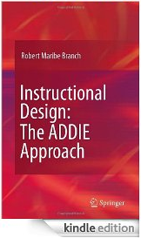
Home Page | ADDIE Help
Create New Project
Analysis
Design
Development
Implementation
Evaluation
Current Projects
ADDIE | What is ADDIE
ADDIE which stands for Analysis, Design, Development, Implementation, and Evaluation is an iterative process that drives instructional design.
Additional Resources: Click the icon to buy online
D
D
D
D
J. Scott Schinall
Ruth C. Clark
Richard E. Mayer
Robert Branch
I
I
Iterative Process
A
A
Help!
E
E
Create New File

Slide 6
Home Page | ADDIE Help | Analysis
Create New Project
Analysis
Design
Development
Implementation
Evaluation
Current Projects
D
D
I
A
ADDIE | Analysis
Involves gathering information to inform decisions about instructional strategies, media and technology, and evaluation of the success of the design.
Common Activities
Help!
E
Create New File

Slide 7
Home Page | ADDIE Help | Analysis | Activities
Create New Project
Analysis
Design
Development
Implementation
Evaluation
Current Projects
ADDIE | Analysis Phase Activities
The following analyses may be conducted:
Instructional Problem - What is the performance issue or behavior that is being targeted?
Stakeholders and Partners -Who is impacted by the performance issue/behavior? Who will be the subject matter experts?
Instructional Goals - What are the general goals for the learner?
Learner Outcomes - How will you know if the learners have met these goals? What changes in performance, knowledge, attitudes, and skills will be observable and measurable?
Learner Characteristics - What prior knowledge do learners have? What are their learning goals and motivation for engaging with the instruction?
Learning Environment - What physical classroom constraints may affect the design of the instruction?
Project Management - What time, resource and staff constraints affect the successful implementation of the project?
Please Note: Most instructional designers will play a major role in this stage to ensure that the instructional design project can be completed on time, on budget, and within scope.
D
D
D
D
I
I
A
A
Help!
E
E
Create New File

Slide 8
Home Page | ADDIE Help | Design
Create New Project
Analysis
Design
Development
Implementation
Evaluation
Current Projects
ADDIE | Design
Involves developing a preliminary design for the new instruction and/or instructional material given the information from the analysis stage.
Common Activities
D
D
I
A
Help!
E
Create New File

Slide 9
Home Page | ADDIE Help | Design | Activities
Create New Project
Analysis
Design
Development
Implementation
Evaluation
Current Projects
ADDIE | Design Phase Activities
The following designs may be developed:
Task design - What are the steps the learner is expected to follow to accomplish a specific task?
Course Objectives (properly referred to as Terminal Objectives)
Enabling Objectives
Information design - How much content will be presented and how will the design draw attention to important information?
User interface or graphic design - What will the handout, Web page, or PowerPoint slide look like? How easy is it for learners to use?
Please Note: Instructional designers will play a major role in this phase. They can communicate their vision to the development team by designing style guides, storyboards, design templates, and low-fidelity prototypes.
D
D
I
A
Help!
E
Create New File

Slide 10
Home Page | ADDIE Help | Development
Create New Project
Analysis
Design
Development
Implementation
Evaluation
Current Projects
ADDIE | Development
Involves the actual creation of any "deliverables" such as a Web page, handouts, PowerPoint slides, or online activities that will be used with learners during implementation.
Common Activities
Current Projects
D
D
I
A
Help!
E
Create New File

Slide 11
Home Page | ADDIE Help | Development | Activities
Create New Project
Analysis
Design
Development
Implementation
Evaluation
Current Projects
ADDIE | Development Phase Activities
The following development activities may be undertaken:
PowerPoint slides
Online activities
eLearning modules
Websites
Handouts
Games
Social media web home pages
Please Note: Different media and technology specialists or staff may be responsible for different aspects of the development stage. Working with a development team needs to be carefully planned and organized to meet deadlines for delivery.
D
D
I
A
Help!
E
Create New File

Slide 12
Home Page | ADDIE Help | Implementation
Create New Project
Analysis
Design
Development
Implementation
Evaluation
Current Projects
D
D
I
ADDIE | Implementation
Describes the first use of the instruction or materials with learners.
Common Activities
A
Help!
E
Create New File

Slide 13
Home Page | ADDIE Help | Implementation | Activities
Create New Project
Analysis
Design
Development
Implementation
Evaluation
Current Projects
ADDIE | Implementation Phase Activities
The following development activities may be undertaken:
Launch website
Launch eLearning
Conduct face-to-face training
Host synchronous online training
Launch social media home page
Please Note: Ideally those involved with the design and development of the instruction and materials will be able to continue to follow the project once it is implemented with actual learners. Learner problems or unforeseen instructional challenges may arise with the first implementation of the new instructional design and materials, so it is important to remember that this stage is part of a process and not simply the end of the design and development project.
D
D
I
A
Help!
E
Create New File

Slide 14
Home Page | ADDIE Help | Evaluation
Create New Project
Analysis
Design
Development
Implementation
Evaluation
Current Projects
D
D
I
A
Help!
E
ADDIE | Evaluation
Involves gathering feedback on the effectiveness of the instructional design of the materials in meeting the original instructional goals and learning objectives. Common Activities
Create New File

Slide 15
Home Page | ADDIE Help | Evaluation | Activities
Create New Project
Analysis
Design
Development
Implementation
Evaluation
Current Projects
ADDIE | Evaluation Phase Activities
The following evaluation activities may be undertaken:
Learner evaluations
Learner knowledge checks, quizzes, assessments
Reflections
Website usage data
Technical support tickets data
Please Note: Certain or all levels of the Kirkpatrick Model are often explored during this phase. If the feedback meets the expectations and goals for the design, then it can be considered summative or final. However, based on this feedback, revisions in the design may be necessary.
D
D
D
D
I
I
A
A
Help!
Help!
E
E
Create New File

Slide 16
Home Page | Current Projects
Create New Project
Analysis
Design
Development
Implementation
Evaluation
Current Projects
D
D
BUMED
I
CIA
A
Help!
E
USPS
View More
Create New File

Slide 17
Home Page | Current Projects
Create New Project
Analysis
Design
Development
Implementation
Evaluation
Current Projects
D
Project Folder
Access files associated with this project
D
BUMED
I
CIA
A
Help!
E
USPS
View More
Create New File

Slide 18
Home Page | Current Projects
Create New Project
Analysis
Design
Development
Implementation
Evaluation
Current Projects
D
D
BUMED
I
Project Folder
Access files associated with this project
CIA
A
Help!
E
USPS
View More
Create New File

Slide 19
Home Page | Current Projects
Create New Project
Analysis
Design
Development
Implementation
Evaluation
Current Projects
D
D
BUMED
I
CIA
Project Folder
Access files associated with this project
A
Help!
E
USPS
View More
Create New File

Slide 20
Home Page | Current Projects
Create New Project
Analysis
Design
Development
Implementation
Evaluation
Current Projects
D
D
BUMED
I
CIA
A
Help!
E
USPS
View More Projects
There are no more projects to view.
View More
Create New File

Slide 21
Home Page | Analysis
Create New Project
Analysis
Design
Development
Implementation
Evaluation
Current Projects
D
Video Notes
Audio Notes
Text Notes
Edited Notes
D
I
A
Help!
E
Create New File

Slide 22
Home Page | Analysis
Create New Project
Analysis
Design
Development
Implementation
Evaluation
Current Projects
D
Video Notes
Audio Notes
Text Notes
Edited Notes
Video Notes Repository
Access archived video files in UX4ID
D
I
A
Help!
E
Create New File

Slide 23
Home Page | Analysis
Create New Project
Analysis
Design
Development
Implementation
Evaluation
Current Projects
D
Video Notes
Audio Notes
Text Notes
Edited Notes
Audio Notes Repository
Access archived audio files in UX4ID
D
I
A
Help!
E
Create New File

Slide 24
Home Page | Analysis
Create New Project
Analysis
Design
Development
Implementation
Evaluation
Current Projects
D
Video Notes
Audio Notes
Text Notes
Edited Notes
Audio Text Repository
Access archived audio files in UX4ID
D
I
A
Help!
E
Create New File

Slide 25
Home Page | Analysis
Create New Project
Analysis
Design
Development
Implementation
Evaluation
Current Projects
D
Video Notes
Audio Notes
Text Notes
Edited Notes
D
Edited Notes Repository
Access video, audio, and text files that have been aggregated and annotated.
I
A
Help!
E
Create New File

Slide 26
Home Page | Design
Create New Project
Analysis
Design
Development
Implementation
Evaluation
Current Projects
D
Sketches
Models
Templates
Toolkit
D
I
A
Help!
E
Create New File

Slide 27
Home Page | Design
Create New Project
Analysis
Design
Development
Implementation
Evaluation
Current Projects
D
Sketches
Models
Templates
Toolkit
Sketch Tools
Access existing sketch pads and visual design tools.
D
I
A
Help!
E
Create New File

Slide 28
Home Page | Design
Create New Project
Analysis
Design
Development
Implementation
Evaluation
Current Projects
D
Sketches
Models
Templates
Toolkit
D
Models and Frameworks
Access instructional design models and frameworks.
I
A
Help!
E
Create New File

Slide 29
Home Page | Design
Create New Project
Analysis
Design
Development
Implementation
Evaluation
Current Projects
D
Sketches
Models
Templates
Toolkit
D
Templates
Access instructional design UX4ID and user-made templates.
I
A
Help!
E
Create New File

Slide 30
Home Page | Design
Create New Project
Analysis
Design
Development
Implementation
Evaluation
Current Projects
D
Sketches
Models
Templates
Toolkit
D
Toolkit
Access mock ups and samples of instructional design best practices.
I
A
Help!
E
Create New File

Slide 31
Home Page | Development
Create New Project
Analysis
Design
Development
Implementation
Evaluation
Current Projects
D
PowerPoint
Camtasia
Captivate
Dreamweaver
D
I
A
Help!
E
Create New File

Slide 32
Home Page | Development
Create New Project
Analysis
Design
Development
Implementation
Evaluation
Current Projects
D
PowerPoint
Camtasia
Captivate
Dreamweaver
D
Application Quick Link
Connect instructional design workflow in UX4ID to work and documents in other vendor applications.
I
A
Help!
E
Create New File

Slide 33
Home Page | Development
Create New Project
Analysis
Design
Development
Implementation
Evaluation
Current Projects
D
PowerPoint
Camtasia
Captivate
Dreamweaver
D
Application Quick Link
Connect instructional design workflow in UX4ID to work and documents in other vendor applications.
I
A
Help!
E
Create New File

Slide 34
Home Page | Development
Create New Project
Analysis
Design
Development
Implementation
Evaluation
Current Projects
D
PowerPoint
Camtasia
Captivate
Dreamweaver
D
Application Quick Link
Connect instructional design workflow in UX4ID to work and documents in other vendor applications.
I
A
Help!
E
Create New File

Slide 35
Home Page | Development
Create New Project
Analysis
Design
Development
Implementation
Evaluation
Current Projects
D
PowerPoint
Camtasia
Captivate
Dreamweaver
D
Application Quick Link
Connect instructional design workflow in UX4ID to work and documents in other vendor applications.
I
A
Help!
E
Create New File

Slide 36
Home Page | Implementation
Create New Project
Analysis
Design
Development
Implementation
Evaluation
Current Projects
D
Adobe Connect
Event Pro
D
I
A
Help!
E
Create New File

Slide 37
Home Page | Implementation
Create New Project
Analysis
Design
Development
Implementation
Evaluation
Current Projects
D
Adobe Connect
Event Pro
D
Application Quick Link
Connect instructional design products to other vendor implementation platforms.
I
A
Help!
E
Create New File

Slide 38
Home Page | Implementation
Create New Project
Analysis
Design
Development
Implementation
Evaluation
Current Projects
D
Adobe Connect
Event Pro
D
Application Quick Link
Connect instructional design products to other vendor implementation platforms.
I
A
Help!
E
Create New File

Slide 39
Home Page | Evaluation
Create New Project
Analysis
Design
Development
Implementation
Evaluation
Current Projects
D
Metrics
Feedback
Portfolio
D
I
A
Help!
E
Create New File

Slide 40
Home Page | Evaluation
Create New Project
Analysis
Design
Development
Implementation
Evaluation
Current Projects
D
Metrics
Feedback
Portfolio
D
Training Metrics Tool
Sync quantitative data from implementation platforms and access data analysis and modeling tools
I
A
Help!
E
Create New File

Slide 41
Home Page | Evaluation
Create New Project
Analysis
Design
Development
Implementation
Evaluation
Current Projects
D
Metrics
Feedback
Portfolio
D
Learner Feedback Tool
Sync and analyze qualitative data from implementation platforms
I
A
Help!
E
Create New File

Slide 42
Home Page | Evaluation
Create New Project
Analysis
Design
Development
Implementation
Evaluation
Current Projects
D
Metrics
Feedback
Portfolio
D
Portfolio
Gather and organize completed products into a live portfolio hosted online and accessible by the UX4ID Community of Practice
I
A
Help!
E
Create New File

Slide 43
Home Page | Widgets Library
Create New Project
Analysis
Design
Development
Implementation
Evaluation
Current Projects
D
D
I
A
Help!
E
Widgets | Widgets Library
Access external applications that support non-ID tasks (e.g., Facebook, Google, Grub Hub, Amazon, etc.)
Create New File

Slide 44
Home Page | Download
Create New Project
Analysis
Design
Development
Implementation
Evaluation
Current Projects
D
D
I
A
Help!
E
Download
Download files from external devices or your system’s hard drive to UX4ID
Create New File

Slide 45
Home Page | Upload
Create New Project
Analysis
Design
Development
Implementation
Evaluation
Current Projects
D
D
I
A
Help!
E
Upload
Upload files from UX4ID to external devices or your system’s hard drive
Create New File

Slide 46
Home Page | Screen Share
Create New Project
Analysis
Design
Development
Implementation
Evaluation
Current Projects
D
D
I
A
Help!
E
Screen Share
Collaborate with colleagues by sharing your UX4ID screen. Internet connection required.
Create New File

Slide 47
Home Page |Camera
Create New Project
Analysis
Design
Development
Implementation
Evaluation
Current Projects
D
D
I
A
Help!
E
Camera
Take photos or video of your screen using the screencam or your environment using the webcam.
Create New File

Slide 48
Home Page | Instant Messenger
Create New Project
Analysis
Design
Development
Implementation
Evaluation
Current Projects
D
D
I
A
Help!
E
Instant Messenger
Connect with colleagues using text, audio, or video instantly.
Create New File

Slide 49
Home Page | Email
Create New Project
Analysis
Design
Development
Implementation
Evaluation
Current Projects
D
D
I
A
Help!
E
Email
Communicate with colleagues via your default email account.
Create New File

Slide 50
Home Page | Calendar
Create New Project
Analysis
Design
Development
Implementation
Evaluation
Current Projects
D
D
I
A
Help!
E
Calendar
Receive alerts from your default calendar account.
Create New File

Slide 51
Home Page
Create New Project
Analysis
Design
Development
Implementation
Evaluation
Current Projects
D
D
I
A
Help!
E
Zoom In/Zoom Out
No current functionality.
Create New File

Slide 52
Home Page | Create New Project
Create New Project
Analysis
Design
Development
Implementation
Evaluation
Current Projects
New ID Project
SUBMIT
D
D
Client Name
I
Project Name
A
Copy File From
USPS
Help!
E
Course Outline
Knowledge Checks
File Name(s)
Objectives
Quiz Questions

Slide 53
Home Page | New Project Created
New Project Created
No further functionality.
Create New Project
Analysis
Design
Development
Implementation
Evaluation
Current Projects
D
D
I
A
Help!
E
Create New File

Slide 54
Task 3
Create a new course objectives

Slide 55
Home Page | Create New File
Create New Project
Analysis
Design
Development
Implementation
Evaluation
Current Projects
D
D
I
To which phase of ADDIE does this file belong?
A
E

Slide 56
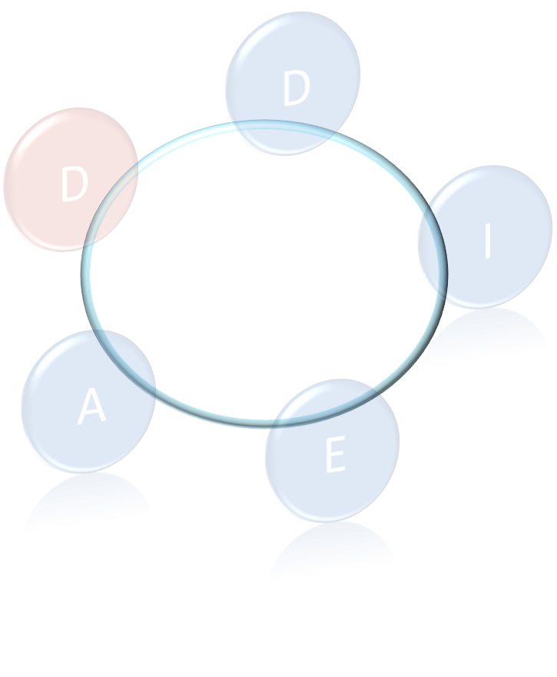
Home Page | Create New File
Create New Project
Analysis
Design
Development
Implementation
Evaluation
Current Projects
Help!

Slide 57
Home Page | New File | Design Activities
Create New Project
Analysis
Design
Development
Implementation
Evaluation
Current Projects
Design Activities
Course Objectives
Knowledge Checks
Ideation Sketching
Quiz Questions
Course Outline
D
D
Storyboard
I
Graphics Design
A
Help!
E

Slide 58
Home Page | New File | Design Activities | Objectives
Create New Project
Analysis
Design
Development
Implementation
Evaluation
Current Projects
Design Activities | Course Objectives
Terminal Objective 1:
Enabling Objective 1:
Enabling Objective 2:
Help!
Enabling Objective 3:
Resources
Terminal Objective 2:
Bloom’s Taxonomy
Enabling Objective 1:
Enabling Objective 2:
Action Verbs
Enabling Objective 3:
Existing Project Files

Slide 59
Home Page | Current Projects | USPS | Files |Objectives
Analysis
Analysis
Design
Design
Development
Development
Implementation
Implementation
Evaluation
Create New Project
Evaluation
Current Projects
File | Home | Insert | Design | Transitions | Animations | Show
_
x
Return to New File Template
D
D
USPS
Files
Course Outline
Resources
A
Help!
E
Knowledge Checks
Objectives

Slide 60
Home Page | New File | Design Activities | Objectives
Create New Project
Analysis
Design
Development
Implementation
Evaluation
Current Projects
Design Activities | Course Objectives
Terminal Objective 1:
Create objectives
No more functionality.
Enabling Objective 1:
Enabling Objective 2:
Help!
Enabling Objective 3:
Resources
Terminal Objective 2:
Bloom’s Taxonomy
Enabling Objective 1:
Enabling Objective 2:
Action Verbs
Enabling Objective 3:
Existing Project Files

Slide 61
Optional Task 4: Activity from former Research Round
Navigate to the USPS “Objectives” file from the Home Page and respond to calendar alerts
Or
Click the next arrow to view the scenario based storyline

Slide 62
Home Page
Create New Project
Analysis
Design
Development
Implementation
Evaluation
Current Projects
D
D
I
A
Help!
E
Create New File

Slide 63
Home Page | Current Projects
Create New Project
Analysis
Design
Development
Implementation
Evaluation
Current Projects
D
D
BUMED
I
CIA
A
Help!
E
USPS
View More
Create New File

Slide 64
Home Page | Current Projects | USPS | Files
Analysis
Analysis
Design
Design
Development
Development
Implementation
Implementation
Evaluation
Create New Project
Evaluation
Current Projects
D
D
USPS
I
Files
Course Outline
A
Help!
E
Knowledge Checks
Create New File
Objectives

Slide 65
Home Page | Current Projects | USPS | Files
Analysis
Analysis
Design
Design
Development
Development
Implementation
Implementation
Evaluation
Create New Project
Evaluation
Current Projects
D
D
USPS
I
Files
Knowledge Checks
A
Help!
E
Objectives
Quiz Questions
Create New File

Slide 66
Home Page | Current Projects | USPS | Files |Objectives
Analysis
Analysis
Design
Design
Development
Development
Implementation
Implementation
Evaluation
Create New Project
Evaluation
Current Projects
File | Home | Insert | Design | Transitions | Animations | Show
_
x
D
D
USPS
Files
Course Outline
A
Help!
E
Knowledge Checks
Create New File
Objectives

Slide 67
Home Page | Current Projects | USPS | Files |Objectives
Analysis
Analysis
Design
Design
Development
Development
Implementation
Implementation
Evaluation
Create New Project
Evaluation
Current Projects
File | Home | Insert | Design | Transitions | Animations | Show
_
x
D
D
USPS
Files
Course Outline
A
Help!
E
Knowledge Checks
Create New File
Objectives

Slide 68
Home Page | Current Projects | USPS | Files |Objectives
Analysis
Analysis
Design
Design
Development
Development
Implementation
Implementation
Evaluation
Create New Project
Evaluation
Current Projects
File | Home | Insert | Design | Transitions | Animations | Show
_
x
D
D
USPS
Files
Course Outline
A
Help!
E
Knowledge Checks
DOD Lunch and Learn
Read
Ignore
Create New File
Objectives

Slide 69
Home Page | Current Projects | USPS | Files |Objectives
Analysis
Analysis
Design
Design
Development
Development
Implementation
Implementation
Evaluation
Create New Project
Evaluation
Current Projects
File | Home | Insert | Design | Transitions | Animations | Show
_
x
D
D
USPS
Files
Course Outline
A
Help!
E
Knowledge Checks
DOD Lunch and Learn
Read
Ignore
Create New File
Objectives

Slide 70
Home Page | Current Projects | USPS | Files |Objectives
Analysis
Analysis
Design
Design
Development
Development
Implementation
Implementation
Evaluation
Create New Project
Evaluation
Current Projects
File | Home | Insert | Design | Transitions | Animations | Show
_
x
D
D
USPS
Files
Course Outline
A
Help!
E
Knowledge Checks
Create New File
Objectives

Slide 71
Home Page | Current Projects | USPS | Files |Objectives
Analysis
Analysis
Design
Design
Development
Development
Implementation
Implementation
Evaluation
Create New Project
Evaluation
Current Projects
File | Home | Insert | Design | Transitions | Animations | Show
_
x
D
D
USPS
Files
Course Outline
A
Help!
E
Knowledge Checks
PM Status Update
Read
Ignore
Create New File
Objectives

Slide 72
Home Page | Current Projects | USPS | Files |Objectives
Analysis
Analysis
Design
Design
Development
Development
Implementation
Implementation
Evaluation
Create New Project
Evaluation
Current Projects
File | Home | Insert | Design | Transitions | Animations | Show
_
x
D
D
USPS
Files
Course Outline
A
Help!
E
Knowledge Checks
PM Status Update
Read
Ignore
Create New File
Objectives

Slide 73
Home Page | Current Projects | USPS | Files |Objectives
Analysis
Analysis
Design
Design
Development
Development
Implementation
Implementation
Evaluation
Create New Project
Evaluation
Current Projects
File | Home | Insert | Design | Transitions | Animations | Show
_
x
D
D
USPS
Files
PM Status Update for BUMED Project
Send brief status update to PM to communicate whether there is a need for more learner analysis.
x
Course Outline
A
Help!
E
Knowledge Checks
Create New File
Objectives

Slide 74
Home Page | Current Projects | USPS | Files |Objectives
Analysis
Analysis
Design
Design
Development
Development
Implementation
Implementation
Evaluation
Create New Project
Evaluation
Current Projects
File | Home | Insert | Design | Transitions | Animations | Show
_
x
D
D
USPS
Files
PM Status Update for BUMED Project
Send brief status update to PM to communicate whether there is a need for more learner analysis.
x
Course Outline
A
Help!
E
Knowledge Checks
Create New File
Objectives

Slide 75
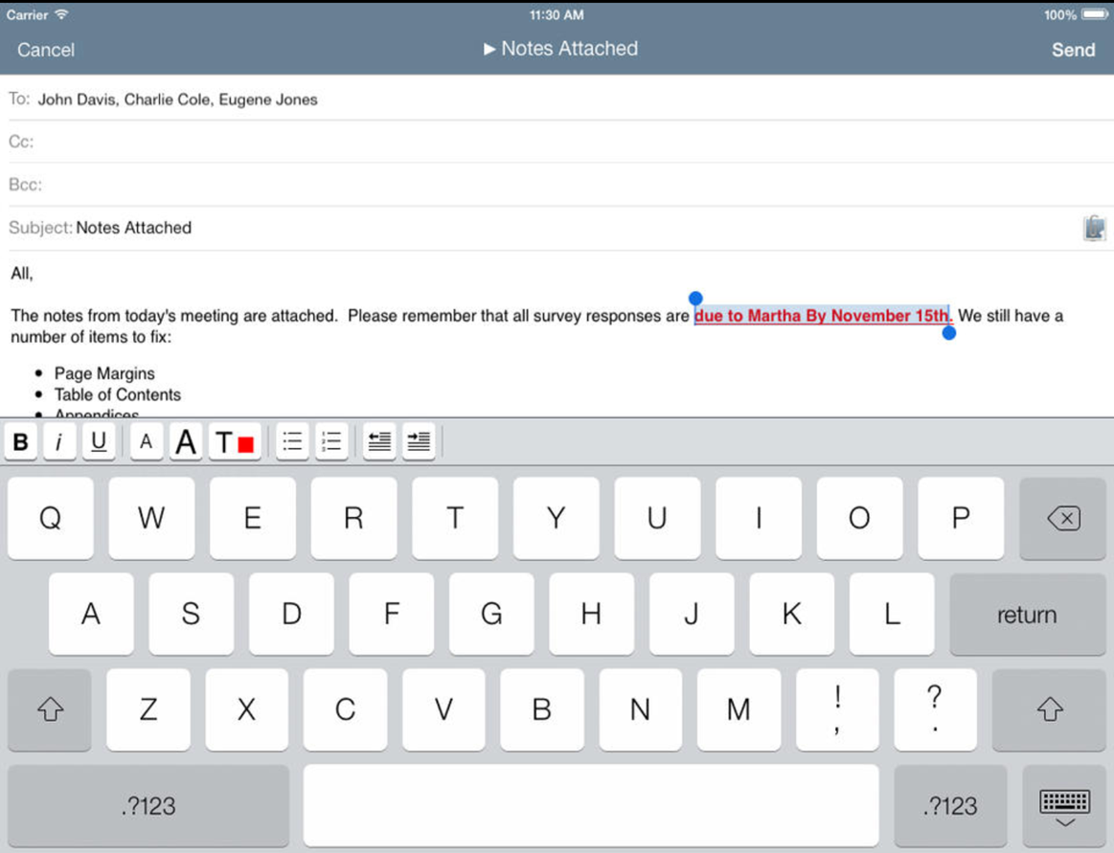
Home Page | Current Projects | USPS | Files |Objectives
Analysis
Analysis
Design
Design
Development
Development
Implementation
Implementation
Evaluation
Create New Project
Evaluation
Current Projects
File | Home | Insert | Design | Transitions | Animations | Show
_
x
D
PM Status Update for BUMED ID Project
Man.Ager@CompanyX.com
D
USPS
PM Status Update for BUMED ID Project
Hello Mr. Ager,
The SME session for the BUMED ID Project was conducted Monday and the learner interview was conducted Tuesday. These interviews revealed inconsistencies between the way in which the SME advised that work be performed and how people in the field are actually doing the work to achieve the mission. Our team has scheduled a follow-up session with the SME. However, we would like to conduct further learner analysis to ensure that the SME guidance is reflective of current work practice. Does this sound like a pl
Files
PM Status Update for BUMED Project
Send brief status update to PM to communicate whether there is a need for more learner analysis.
x
plan
Course Outline
A
Help!
E
Knowledge Checks
Create New File
Objectives

Slide 76
Home Page | Current Projects | USPS | Files |Objectives
Analysis
Analysis
Design
Design
Development
Development
Implementation
Implementation
Evaluation
Create New Project
Evaluation
Current Projects
File | Home | Insert | Design | Transitions | Animations | Show
_
x
D
PM Status Update for BUMED ID Project
Man.Ager@CompanyX.com
D
USPS
PM Status Update for BUMED ID Project
Hello Mr. Ager,
The SME session for the BUMED ID Project was conducted Monday and the learner interview was conducted Tuesday. These interviews revealed inconsistencies between the way in which the SME advised that work be performed and how people in the field are actually doing the work to achieve the mission. Our team has scheduled a follow-up session with the SME. However, we would like to conduct further learner analysis to ensure that the SME guidance is reflective of current work practice. Does this sound like a plan?
Files
Course Outline
A
Help!
E
Knowledge Checks
Create New File
Objectives

Slide 77
Home Page | Current Projects | USPS | Files |Objectives
Analysis
Analysis
Design
Design
Development
Development
Implementation
Implementation
Evaluation
Create New Project
Evaluation
Current Projects
File | Home | Insert | Design | Transitions | Animations | Show
_
x
D
PM Status Update for BUMED ID Project
Man.Ager@CompanyX.com
D
Attach a file to this item
USPS
PM Status Update for BUMED ID Project
Hello Mr. Ager,
The SME session for the BUMED ID Project was conducted Monday and the learner interview was conducted Tuesday. These interviews revealed inconsistencies between the way in which the SME advised that work be performed and how people in the field are actually doing the work to achieve the mission. Our team has scheduled a follow-up session with the SME. However, we would like to conduct further learner analysis to ensure that the SME guidance is reflective of current work practice. Does this sound like a plan?
Files
Course Outline
A
Help!
E
Knowledge Checks
Create New File
Objectives

Slide 78
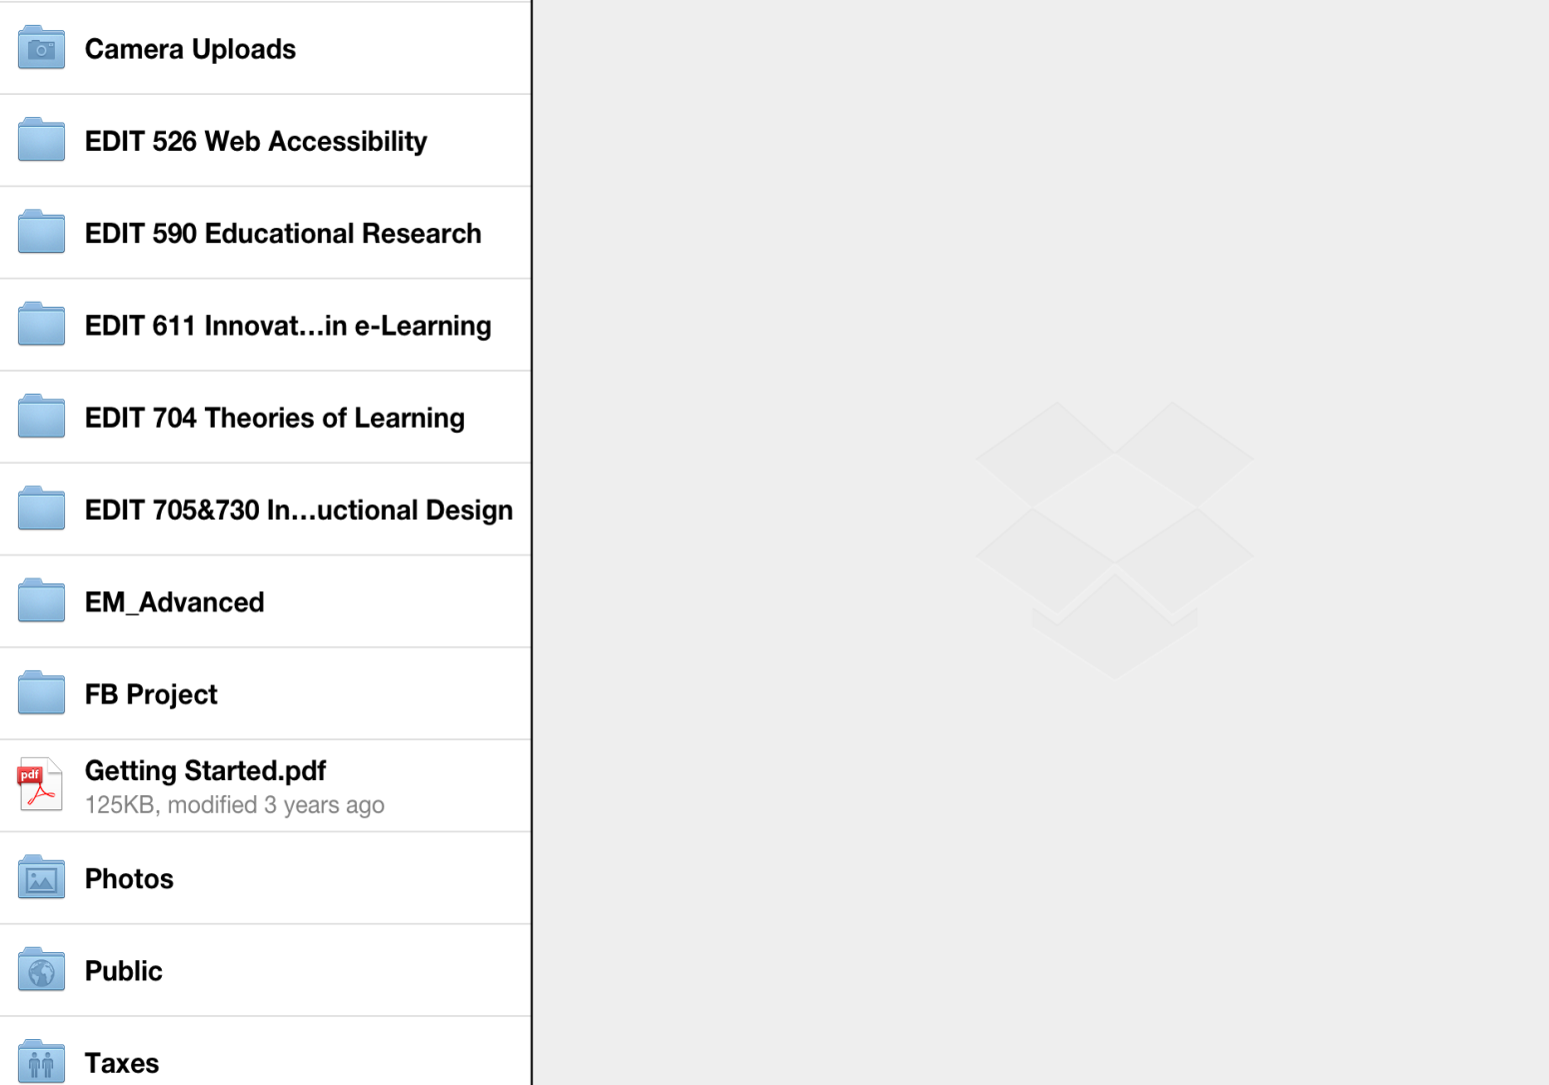
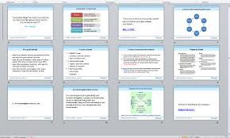
Home Page | Current Projects | USPS | Files |Objectives
Analysis
Analysis
Design
Design
Development
Development
Implementation
Implementation
Evaluation
Create New Project
Evaluation
Current Projects
File | Home | Insert | Design | Transitions | Animations | Show
_
x
Camera Uploads
D
Audio
Video
D
USPS
Text Documents
Files
Images
Shared
Course Outline
Public
SME_Session_Visual_BUMED.pptx
SME_Interview_2_BUMED.mp3
A
Help!
SME_Interview_1_BUMED.mp4
E
Knowledge Checks
SME_Session_Noetes_BUMED.docx
SME_Session_Visual_BUMED.pptx
BUMED_objectives.pdf
Create New File
Objectives

Slide 79
Home Page | Current Projects | USPS | Files |Objectives
Analysis
Analysis
Design
Design
Development
Development
Implementation
Implementation
Evaluation
Create New Project
Evaluation
Current Projects
File | Home | Insert | Design | Transitions | Animations | Show
_
x
Camera Uploads
D
Audio
Video
D
USPS
Text Documents
Files
Images
Shared
Course Outline
Public
SME_Session_Visual_BUMED.pptx
SME_Interview_2_BUMED.mp3
A
Help!
SME_Interview_1_BUMED.mp4
E
Knowledge Checks
SME_Session_Noetes_BUMED.docx
SME_Session_Visual_BUMED.pptx
BUMED_objectives.pdf
Create New File
Objectives

Slide 80
Home Page | Current Projects | USPS | Files |Objectives
Analysis
Analysis
Design
Design
Development
Development
Implementation
Implementation
Evaluation
Create New Project
Evaluation
Current Projects
File | Home | Insert | Design | Transitions | Animations | Show
_
x
D
PM Status Update for BUMED ID Project
To:
Man.Ager@CompanyX.com
Cc:
Attachments:
D
SME_Session_Visual_BUMED.pptx
USPS
Subject:
PM Status Update for BUMED ID Project
Hello Mr. Ager,
The SME session for the BUMED ID Project was conducted Monday and the learner interview was conducted Tuesday. These interviews revealed inconsistencies between the way in which the SME advised that work be performed and how people in the field are actually doing the work to achieve the mission. Our team has scheduled a follow-up session with the SME. However, we would like to conduct further learner analysis to ensure that the SME guidance is reflective of current work practice. Does this sound like a plan?
Becca Tremble
Instructional Designer
Company X
1919 N. Lynn Street, Arlington, VA
Mobile: +1 123-456-789
b.tremble@companyx.com
Files
Course Outline
A
Help!
E
Knowledge Checks
Create New File
Objectives

Slide 81
Home Page | Current Projects | USPS | Files |Objectives
Analysis
Analysis
Design
Design
Development
Development
Implementation
Implementation
Evaluation
Evaluation
Current Projects
File | Home | Insert | Design | Transitions | Animations | Show
_
x
D
PM Status Update for BUMED ID Project
To:
Man.Ager@CompanyX.com
Cc:
Attachments:
D
SME_Session_Visual_BUMED.pptx
USPS
Subject:
PM Status Update for BUMED ID Project
Hello Mr. Ager,
The SME session for the BUMED ID Project was conducted Monday and the learner interview was conducted Tuesday. These interviews revealed inconsistencies between the way in which the SME advised that work be performed and how people in the field are actually doing the work to achieve the mission. Our team has scheduled a follow-up session with the SME. However, we would like to conduct further learner analysis to ensure that the SME guidance is reflective of current work practice. Does this sound like a plan?
Becca Tremble
Instructional Designer
Company X
1919 N. Lynn Street, Arlington, VA
Mobile: +1 123-456-789
b.tremble@companyx.com
Files
Course Outline
A
Help!
E
Knowledge Checks
Objectives

Slide 82
Home Page | Current Projects | USPS | Files |Objectives
Analysis
Analysis
Design
Design
Development
Development
Implementation
Implementation
Evaluation
Create New Project
Evaluation
Current Projects
File | Home | Insert | Design | Transitions | Animations | Show
_
x
D
PM Status Update for BUMED ID Project
To:
Man.Ager@CompanyX.com
Cc:
Attachments:
D
SME_Session_Visual_BUMED.pptx
USPS
Subject:
PM Status Update for BUMED ID Project
Hello Mr. Ager,
The SME session for the BUMED ID Project was conducted Monday and the learner interview was conducted Tuesday. These interviews revealed inconsistencies between the way in which the SME advised that work be performed and how people in the field are actually doing the work to achieve the mission. Our team has scheduled a follow-up session with the SME. However, we would like to conduct further learner analysis to ensure that the SME guidance is reflective of current work practice. Does this sound like a plan?
Becca Tremble
Instructional Designer
Company X
1919 N. Lynn Street, Arlington, VA
Mobile: +1 123-456-789
b.tremble@companyx.com
Files
Course Outline
A
Help!
E
Knowledge Checks
Create New File
Objectives

