Slide 1
EDIT 732 Final Presentation 11 December 2013
Group B
Anne Millen-Martini
Nkiruka Ogbuchiekwe
Eric Reeves
Julie Steward
Anya Stolpe
Olivia Wang
Notes:
Good afternoon/evening. We are team B.

Slide 2
Agenda
Introduction
Overview
Storyboard/design process
Application of the Tool
Lessons Learned
Conclusion
Notes:
This is our agenda for our presentation

Slide 3
Notes:
Our project focused on developing a tool to assist instructional designers develop their products while integrating user experience concepts into their processes. As we progressed through our project, we felt the Russian nesting doll was an appropriate “analogy” for our situation – we were the IDs using UX to design a tool to teach and assist IDs to use UX in the design of their products. It caused us some confusion in the beginning, but also kept us in “grounded theory” mindset – focusing us on a thorough analysis of the data collected from our instructional designer interviewees.

Slide 4
Notes:
We interviewed 7 actively-working IDs, and from their input, developed the application you see now – the User Experience for Instructional Designers or UX4ID prototype. On the right are the calendar and daily schedule; and along the bottom are the widgets that our ID has selected from the widgets library and tailored to provide her the easiest access and most efficient way to access the tools she uses most frequently on a daily basis. On the left you can see the 3 projects our instructional designer is working on – one for the Navy Bureau of Medicine and Surgery, one for the Central Intelligence Agency, and one for the US Postal Service.

Slide 5
Analysis
Design
Development
Implementation
Evaluation
Video Notes
Audio notes
Notes Storage
Notes:
The top bar reflects the ADDIE framework for ID and is a very explicit example of where the user experience and the instructional design processes intersect. Each of these buttons give us access to the tools we are most likely to use during this phase and that could be tailored to our specific preferences, and aligned to the individual projects. In this case the ID has pulled the video notes and studio note from the accessible link.

Slide 6
Analysis
Design
Development
Implementation
Evaluation
Notes:
During the design phase, the ID used or is using the objectives link to access Bloom’s Taxonomy as a reference, and has placed templates here for easy access.

Slide 7
Analysis
Design
Development
Implementation
Evaluation
Data Storage
Notes:
Here are the links pulled out for development.

Slide 8
Analysis
Design
Development
Implementation
Evaluation
Metrics
Notes:
As the ID plans for the implementation phase, she is able to capture metrics from her Kirkpatrick assessment, and add in other metrics and measures that satisfy her clients requirements.

Slide 9
Analysis
Design
Development
Implementation
Evaluation
Portfolio
Feedback
Notes:
The evaluation link provides access to data from each step of the process, culminating in a summative assessment of the entire project.
Now that you’ve seen an overview of the UX4ID tool, we would like to step back and take you through the process we used to come up with the functionality by introducing you to our persona of Rebecca Trimble. This persona was based on the information we gleaned from our interviews of instructional designers. We will then show you some example of how the functionally of this tool really works to help the ID get through the work day.

Slide 10
Introducing: Becca, the instructional designer!
Ok, off to the car…
No worries, Jared, just come get me when you can.

Slide 11
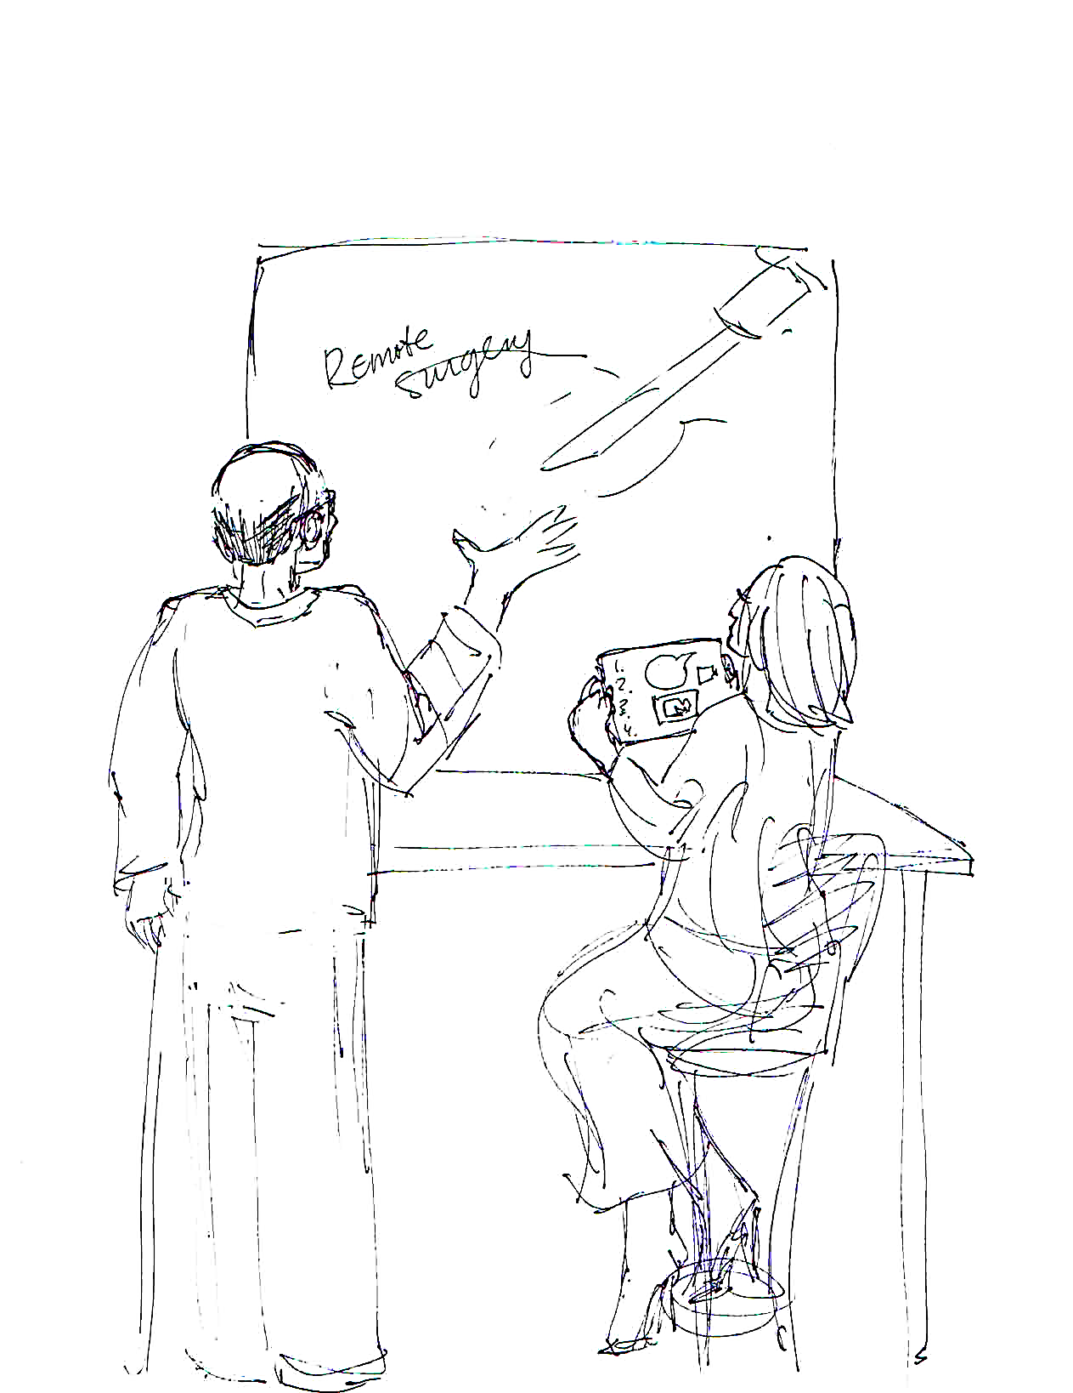
WORKING WITH A SME ON ANALYSIS:

Slide 12
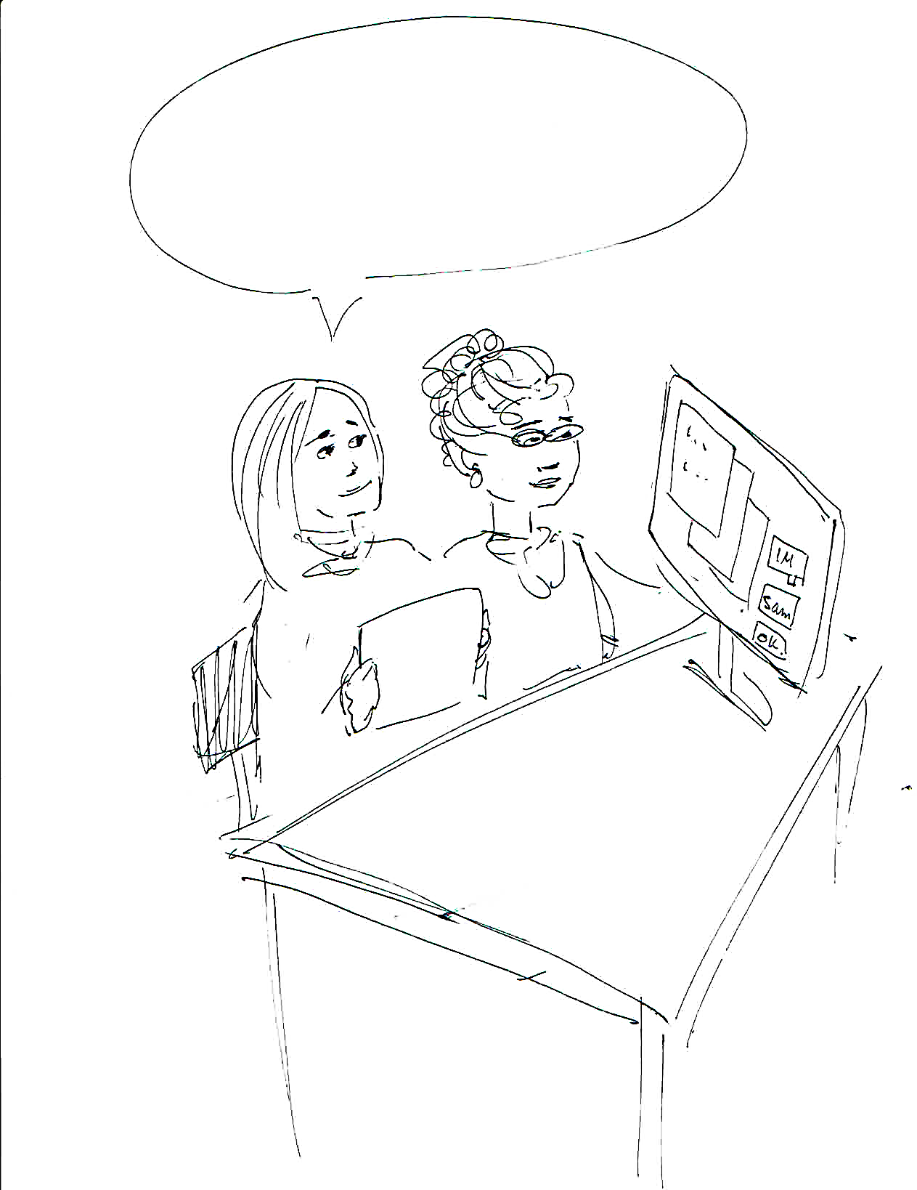
PREPPING FOR A USER INTERVIEW (ANALYSIS):
This will just take a sec, Amanda, and it could save us a lot of time and frustration later…
We need to know the tech specs for their equipment… ooh, this might help,
Go Sam!
I should ask if we can
place the captioning here…
“Ping!”

Slide 13
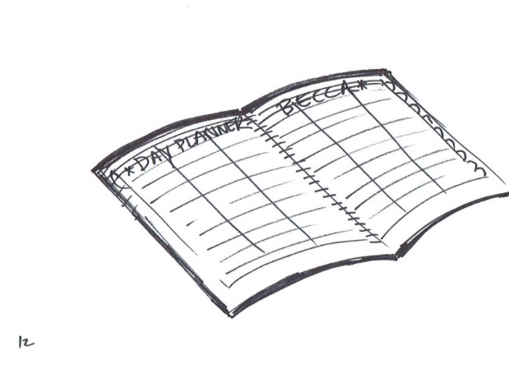
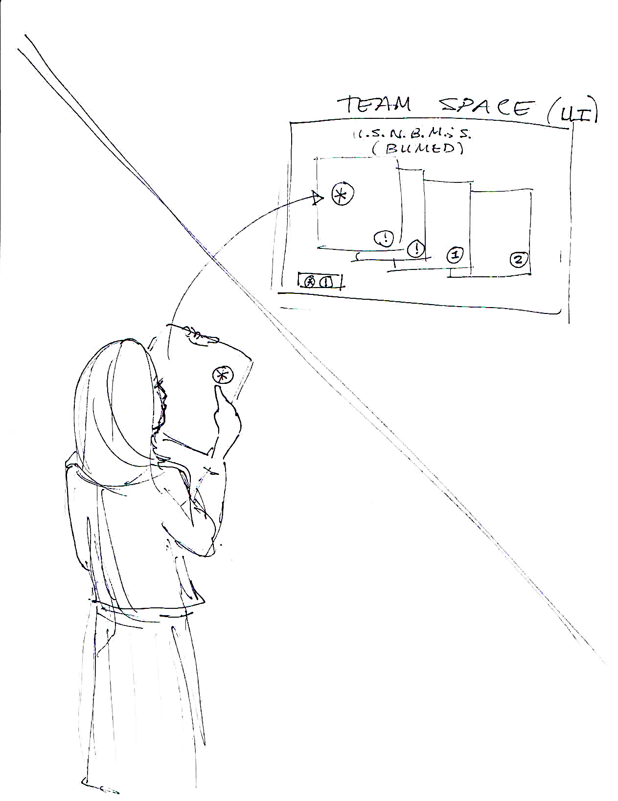
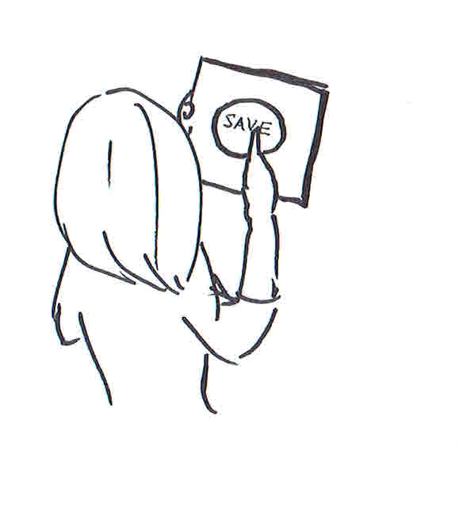
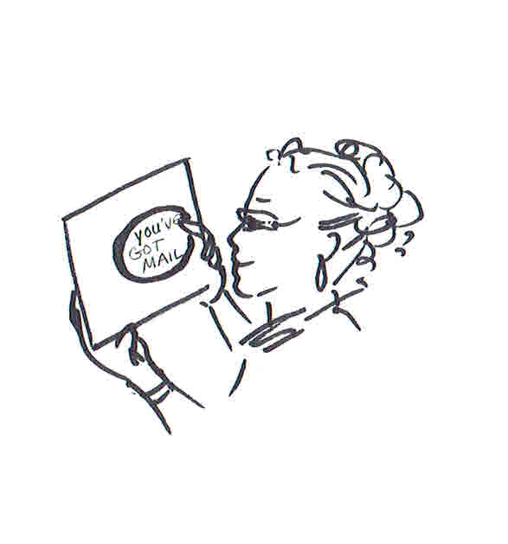
USER INTERVIEW AND ANALYSIS:

Slide 14
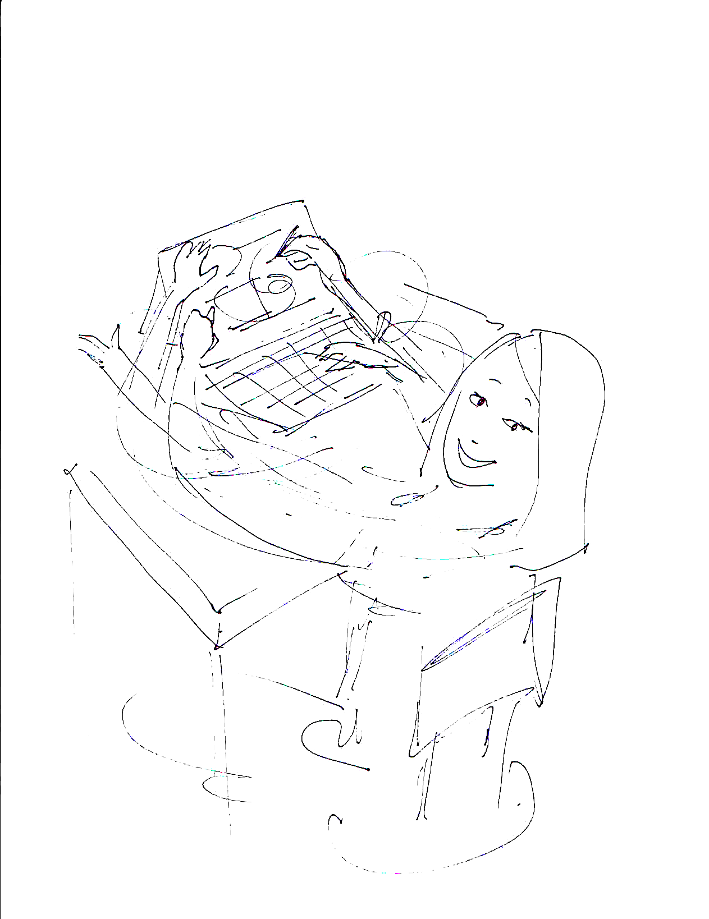
FOCUSING ON DESIGN:
WITH WIREFRAMES

Slide 15
Analysis
Design
Development
Implementation
Evaluation
Sketching
Modeling
Objectives
Templates
Collaboration
File | Home | Insert | Design | Transitions | Animations | Show
_
x
Notes:
Interaction Notes
1. None-add animation to simulate automatic pop-up
Question for Anya
This is the only instructional design project template I could find in my archives. Would it make more sense for us to just change the client from the Department of State to United States Postal Service SOX Compliance. At the end of the day, we will not have time to go into the details about the projects she is working on? What are your thoughts? –
From Anya
I changed it to USPS in the Prototype – now we need to update documents

Slide 16
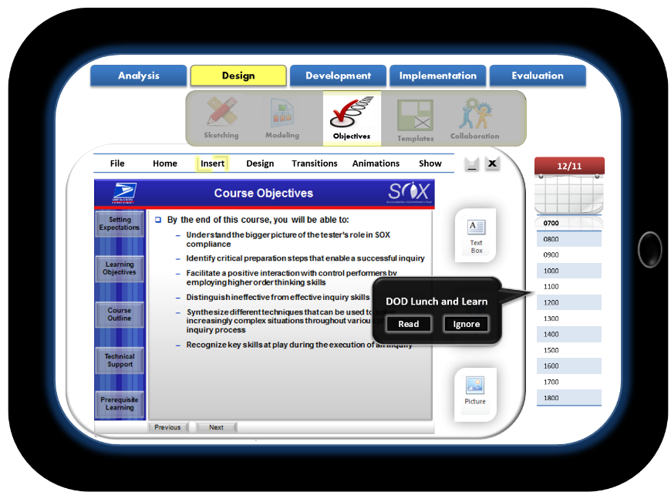
Analysis
Design
Development
Implementation
Evaluation
Sketching
Modeling
Objectives
Templates
Collaboration
File | Home | Insert | Design | Transitions | Animations | Show
_
x
DOD Lunch and Learn
Read
Ignore
Notes:
Interaction Notes
1. Click ignore- add animation to simulate transition

Slide 18
Analysis
Design
Development
Implementation
Evaluation
Sketching
Modeling
Objectives
Templates
Collaboration
File | Home | Insert | Design | Transitions | Animations | Show
_
x
DOD Lunch and Learn
Read
Ignore
Notes:
Interaction Notes
1. None – add animation to simulate the pop-up disappearing from the screen

Slide 19
Analysis
Design
Development
Implementation
Evaluation
Sketching
Modeling
Objectives
Templates
Collaboration
File | Home | Insert | Design | Transitions | Animations | Show
_
x
PM Status Update
Read
Ignore
Notes:
Interaction Notes
1. Click read- add animation to simulate transition

Slide 20
Analysis
Design
Development
Implementation
Evaluation
Sketching
Modeling
Objectives
Templates
Collaboration
File | Home | Insert | Design | Transitions | Animations | Show
_
x
PM Status Update
Read
Ignore
Notes:
Interaction Notes
1. None – Add animation to show roll over.

Slide 21
Analysis
Design
Development
Implementation
Evaluation
Sketching
Modeling
Objectives
Templates
Collaboration
File | Home | Insert | Design | Transitions | Animations | Show
_
x
PM Status Update for BUMED Project
Send brief status update to PM to communicate whether there is a need for more learner analysis.
x
Notes:
Interaction Notes
1. Click the mail icon – add animation to simulate transition

Slide 22
Analysis
Design
Development
Implementation
Evaluation
Sketching
Modeling
Objectives
Templates
Collaboration
File | Home | Insert | Design | Transitions | Animations | Show
_
x
PM Status Update for BUMED Project
Send brief status update to PM to communicate whether there is a need for more learner analysis.
x
Notes:
Interaction Notes
1. None – add animation to simulate the pop-up disappearing from the screen

Slide 23
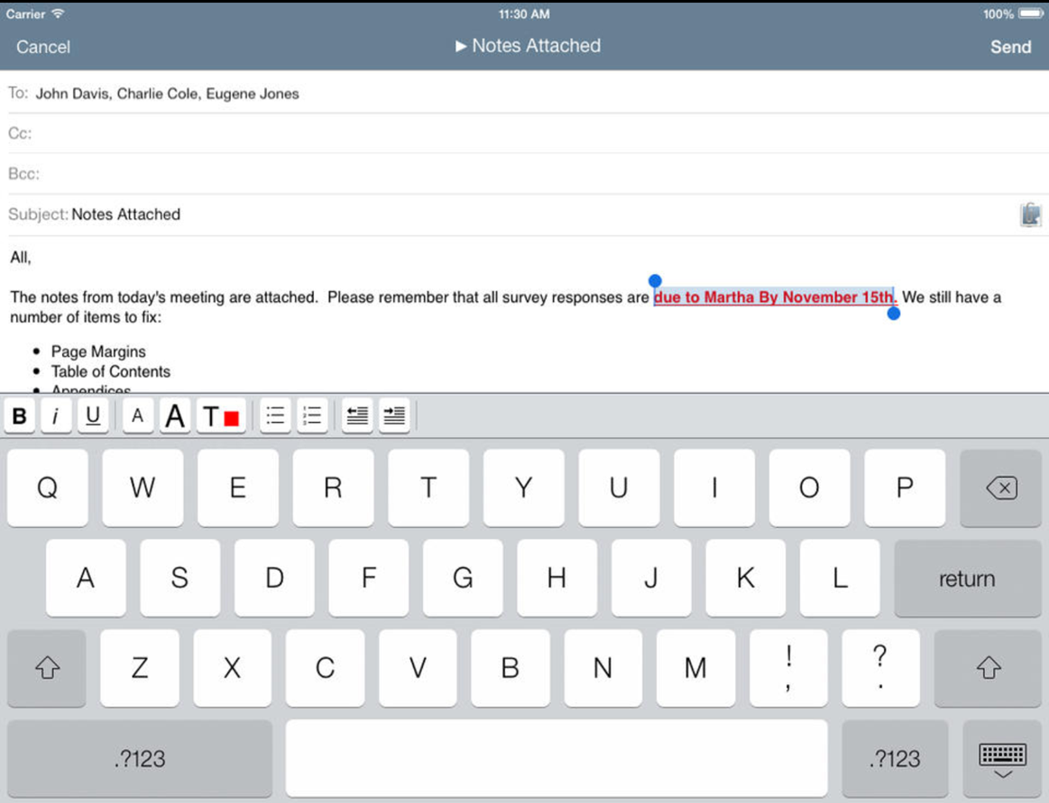
Analysis
Design
Development
Implementation
Evaluation
PM Status Update for BUMED ID Project
Man.Ager@CompanyX.com
PM Status Update for BUMED ID Project
Hello Mr. Ager,
The SME session for the BUMED ID Project was conducted Monday and the learner interview was conducted Tuesday. These interviews revealed inconsistencies between the way in which the SME advised that work be performed and how people in the field are actually doing the work to achieve the mission. Our team has scheduled a follow-up session with the SME. However, we would like to conduct further learner analysis to ensure that the SME guidance is reflective of current work practice. Does this sound like a pl
plan
Notes:
Interaction Notes
1. None – add animation to simulate the message being typed on the screen.
Note for Anya
The verisimilitude here is lacking. Do you know of a way that we can make this email visual seem more real, like something you could actually type into? Should I make it larger? Should we just provide the blank email then enter a text box on top of it so that we can simulate the text being typed on the screen?

Slide 24
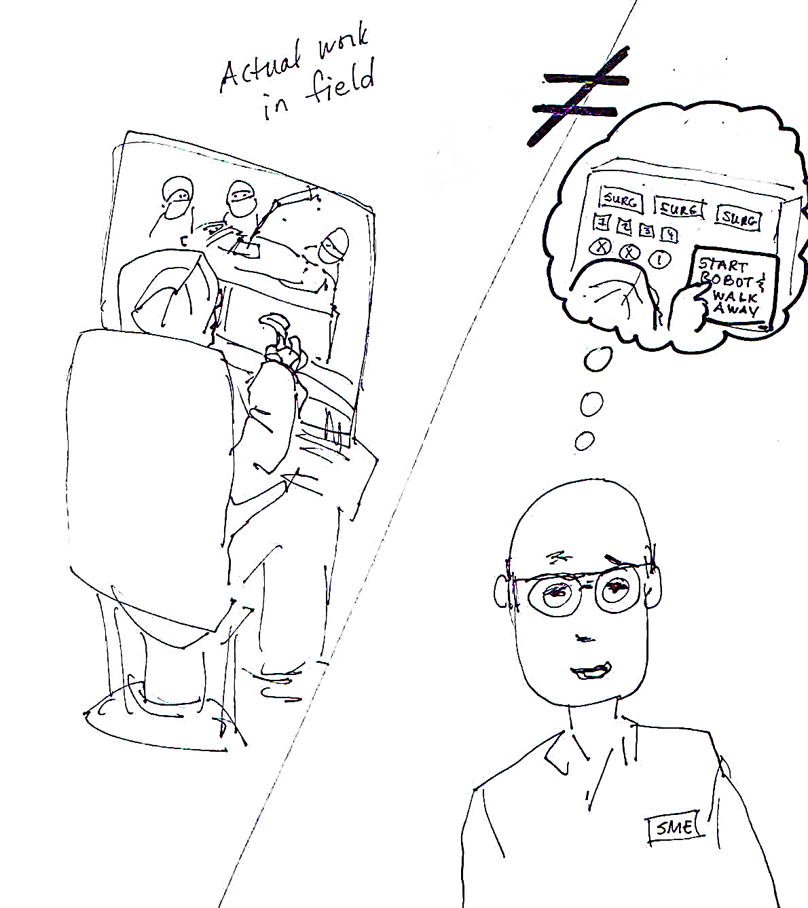
Analysis
Design
Development
Implementation
Evaluation
PM Status Update for BUMED ID Project
Man.Ager@CompanyX.com
Attach a file to this item
PM Status Update for BUMED ID Project
Hello Mr. Ager,
The SME session for the BUMED ID Project was conducted Monday and the learner interview was conducted Tuesday. These interviews revealed inconsistencies between the way in which the SME advised that work be performed and how people in the field are actually doing the work to achieve the mission. Our team has scheduled a follow-up session with the SME. However, we would like to conduct further learner analysis to ensure that the SME guidance is reflective of current work practice. Does this sound like a plan?
Notes:
Interaction Notes
1. Click attach – add animation to simulate transition

Slide 26
Analysis
Design
Development
Implementation
Evaluation
PM Status Update for BUMED ID Project
PM Status Update for BUMED ID Project
To:
To:
Man.Ager@CompanyX.com
Man.Ager@CompanyX.com
Cc:
Cc:
SME_Session_Notes_BUMED.docx
Attachments:
SME_Session_Notes_BUMED.docx
Attachments:
SME_Session_Visual_BUMED.pptx
SME_Session_Visual_BUMED.pptx
PM Status Update for BUMED ID Project
Subject:
PM Status Update for BUMED ID Project
Subject:
Hello Mr. Ager,
The SME session for the BUMED ID Project was conducted Monday and the learner interview was conducted Tuesday. These interviews revealed inconsistencies between the way in which the SME advised that work be performed and how people in the field are actually doing the work to achieve the mission. Our team has scheduled a follow-up session with the SME. However, we would like to conduct further learner analysis to ensure that the SME guidance is reflective of current work practice. Does this sound like a plan?
Becca Tremble
Instructional Designer
Company X
1919 N. Lynn Street, Arlington, VA
Mobile: +1 123-456-789
b.tremble@companyx.com
Hello Mr. Ager,
The SME session for the BUMED ID Project was conducted Monday and the learner interview was conducted Tuesday. These interviews revealed inconsistencies between the way in which the SME advised that work be performed and how people in the field are actually doing the work to achieve the mission. Our team has scheduled a follow-up session with the SME. However, we would like to conduct further learner analysis to ensure that the SME guidance is reflective of current work practice. Does this sound like a plan?
Becca Tremble
Instructional Designer
Company X
1919 N. Lynn Street, Arlington, VA
Mobile: +1 123-456-789
b.tremble@companyx.com
Notes:
Interaction Notes
1. Click attach – add animation to simulate transition

Slide 27
Analysis
Design
Development
Implementation
Evaluation
PM Status Update for BUMED ID Project
To:
Man.Ager@CompanyX.com
Sketching
Modeling
Objectives
Templates
Collaboration
Cc:
File | Home | Insert | Design | Transitions | Animations | Show
x
x
Attachments:
SME_Session_Visual_BUMED.pptx
SME_Session_Notes_BUMED.docx
Subject:
PM Status Update for BUMED ID Project
Hello Mr. Ager,
The SME session for the BUMED ID Project was conducted Monday and the learner interview was conducted Tuesday. These interviews revealed inconsistencies between the way in which the SME advised that work be performed and how people in the field are actually doing the work to achieve the mission. Our team has scheduled a follow-up session with the SME. However, we would like to conduct further learner analysis to ensure that the SME guidance is reflective of current work practice. Does this sound like a plan?
Becca Tremble
Instructional Designer
Company X
1919 N. Lynn Street, Arlington, VA
Mobile: +1 123-456-789
b.tremble@companyx.com
Notes:
Interaction Notes
1. Click the minimize button– add animation to simulate visual minimizing

Slide 28
Analysis
Design
Development
Implementation
Evaluation
Sketching
Modeling
Objectives
Templates
Collaboration
File | Home | Insert | Design | Transitions | Animations | Show
x
x
Notes:
Interaction Notes
1. Click the minimize button– add animation to simulate visual minimizing

Slide 29
Analysis
Design
Development
Implementation
Evaluation
Sketching
Modeling
Objectives
Templates
Collaboration
File | Home | Insert | Design | Transitions | Animations | Show
_
x
Notes:
Interaction Notes
1. Click the minimize button– add animation to simulate visual minimizing

Slide 30
Analysis
Design
Development
Implementation
Evaluation
Sketching
Modeling
Objectives
Templates
Collaboration
File | Home | Insert | Design | Transitions | Animations | Show
q
x
Notes:
Interaction Notes
1. Click the widgets icon– add animation to simulate transition

Slide 31
Analysis
Design
Development
Implementation
Evaluation
Sketching
Modeling
Objectives
Templates
Collaboration
File | Home | Insert | Design | Transitions | Animations | Show
q
x
Widgets Library
Notes:
Interaction Notes
1. None– add animation to simulate transition

Slide 32
Analysis
Design
Development
Implementation
Evaluation
Sketching
Modeling
Objectives
Templates
Collaboration
File | Home | Insert | Design | Transitions | Animations | Show
q
x
Order Lunch
Widgets Library
Notes:
Interaction Notes
1. Click lunch ordering icon– …
Notes for Anya
Can you enter some icons in the blue space of the widgets we would find here. We would need to highlight on the widget to order lunch.

Slide 33
Analysis
Design
Development
Implementation
Evaluation
Sketching
Modeling
Objectives
Templates
Collaboration
File | Home | Insert | Design | Transitions | Animations | Show
_
x
Notes:
Interaction Notes
1. Click the maximize button– add animation to simulate visual expanding on screen.

Slide 34
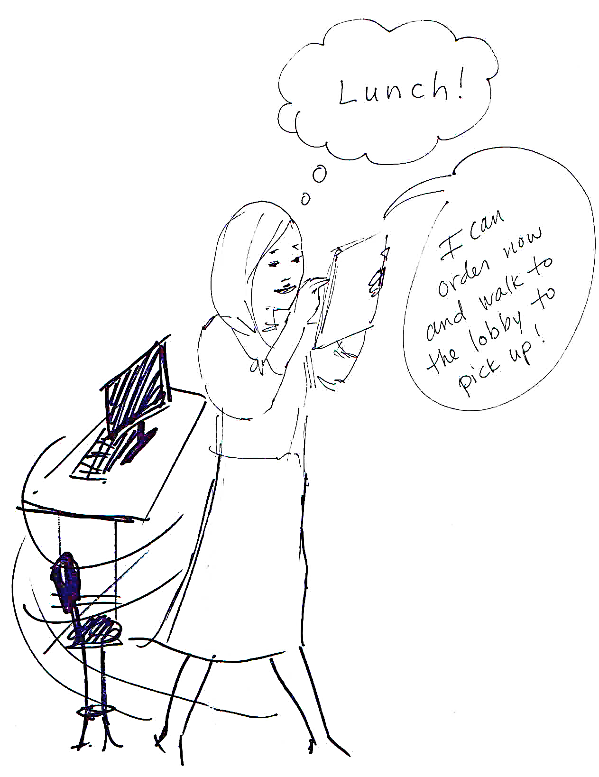

Slide 35
KEY TAKEAWAYS
Our Mission: To develop an application that enables Instructional Designers to utilize user experience design in their projects.
Our Process: Involved mapping out a design process within a design process and staying true to the key principles of each.
Our Prototype: Follows a scenario based approach to the T-model to ensure that our tool demonstrated how a typical user would actually interact with the tool and not just an application overview
Lessons Learned: Both instructional design and user experience design are iterative processes that involved the construction, deconstruction, and reconstruction of design ideas
Notes:
Our Mission: To develop an application that enables Instructional Designers to utilize user experience design in their projects
Our Process: Involved mapping out a design process within a design process and staying true to the key principles of each
Our Prototype: Follows a scenario-based approach to the T-model to ensure that our tool demonstrated how a typical user would actually interact with the tool and not just an application overview
Lessons Learned: Realized that both instructional design and user experience design are iterative processes that involved the construction, deconstruction, and reconstruction of design ideas

Slide 36
CONCLUSION: Why UX4ID
Notes:
So, you may be wondering, why this approach? Why UX4ID?
This is a wordle of our WAN conclusions.
In our analysis phase we found that some of the most commonly cited themes included
Training and ID: Our target audience expressed a consistent need for training tools that not only align to the ADDIE methodology. We wanted to go one step further and design a tool that not only aligns, but also facilitates their adherence to ADDIE.
User and Learner: Instructional designers may not use the term user experience design, but they commonly described some of the key principles of the methodology. So, we developed a tool that could increased the effectiveness of their deliverables by making them more learner-focused. In UX4ID, the Instructional Designer is given direct access to the learner and SMEs that informs the learners’ work.
Analysis and Design: Instructional designers spend the majority of their time and efforts in the Analysis and Design phase of a project. Accordingly, we developed an application that would provide endless tools, resources guides, and repositories to support the analysis and design phase of several projects simultaneously. In UX4ID, the Instructional Designer is building their own resource library which can be repurposed and shared for future projects.

Slide 37
PLANS FOR NEXT SEMESTER
Refine navigation between the application and widgets
Build the resource library
Identify a technology to develop our application
Test syncing capability with the top ID development tools
Notes:
Looking ahead, our team will continue to refine the navigation between our app and the widgets it interacts with in order to reduce distraction, which is one of the greatest challenges instructional designers face in their day-to-day work. We will also continue to refine our resource library so that designers have easy access to the best support for instructional and user experience design available, particularly in the analysis, design, and evaluation stages. Finally, we plan to develop synching ability with the top development tools currently in use to empower designers with the most flexible and effective options for their teams (i.e. Captivate, Camtasia, PowerPoint, etc.)

Slide 38
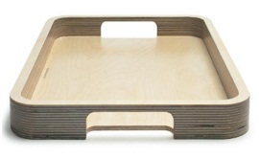
Analysis
Design
Development
Implementation
Evaluation
12/11
BUMED
0700
0800
0900
1000
1100
1200
1300
1400
1500
1600
1700
1800
CIA
DOS
Widgets Library
Timecard
MS
Project
MS
Outlook
Dragon
Dictation
Expensify
Tableau

